Slide 1
Contraception

Slide 2
Contraception
3.3 million pregnancies are unplanned each year
North Carolina featured 50-56 per 1000 in 2008
We all know someone who had an unplanned pregnancy many times these are teen agers when this occurred.

Slide 3
Contraception
Two main types Barrier and Chemical
Barrier Contraception creates a barrier that the sperm cells cannot pass through.
Chemical Birth Control chemically inhibits the fertilization process.

Slide 4
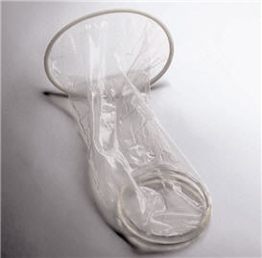
Female Condom

Slide 5
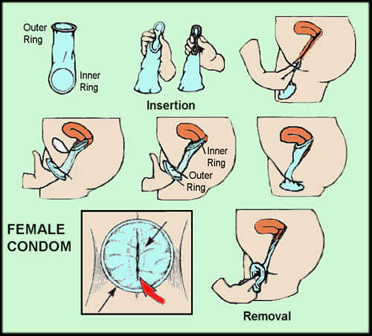
Female Condom
Female Condoms are between 75-82% effective depending on whether or not they are inserted correctly.

Slide 6
Female Condom
Female Condoms are awkward to use and expensive when compared to male condoms.
Cannot be used with a male condom, will break
Must be inserted prior to sexual intercourse.
Should be checked for punctures after sexual intercourse.

Slide 7
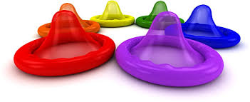
Male Condom
Highly effective
Up to 98% effective
Protects against pregnancy and sexually transmitted infections
Free at state health centers
Very cost effective form of birth control
Easy to use correctly

Slide 8
Diaphragm
Female Diaphragm is a barrier device inserted prior to sexual activity designed to block sperm from getting to uterus.
Must be used with a contraceptive foam
Must be measured to ensure correct fit.
Fragile, they are easily punctured

Slide 9
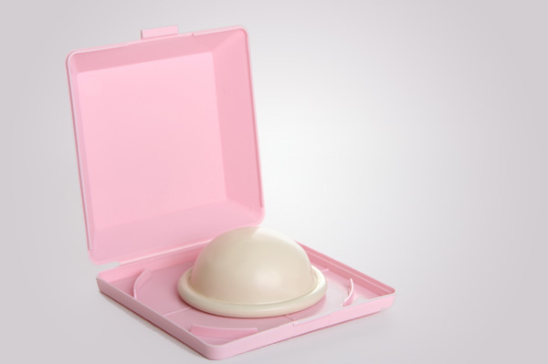
Diaphragm

Slide 10
Diaphragm
Effective rates for Diaphragm are 80-85% in preventing pregnancies.
Easy to position incorrectly
Must be inserted directly before sexual activity.

Slide 11
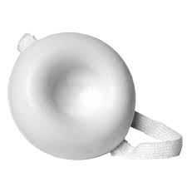
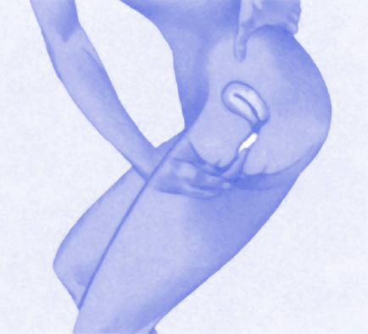
Sponge

Slide 12
Sponge
Barrier device that can be inserted up to 24 hours before sex.
Effective rates are as high as 91% if used correctly and before every sexual encounter.
Most must be wet prior to insertion.
Must remain in place for at least six hours after sex.
Combines the barrier of the material with a spermicide to kill sperm.

Slide 13
Chemical Birth Control
Birth Control Pill “the pill”
Implanon
Vaginal Ring
Skin Patches
Plan B
IUD
Depo

Slide 14
Birth Control Pill
Pills taken to chemically inhibit pregnancy
Must be taken regularly at same time for maximum effectiveness.
98-99% effective when used correctly.

Slide 15
Vaginal Ring
Nuva Ring is a flexible plastic ring inserted into the vagina and left for one month.
It releases chemicals that prevent egg fertilization
Can be dislodged during sex, just clean and re-insert
Up to 95% effective when used correctly.

Slide 16
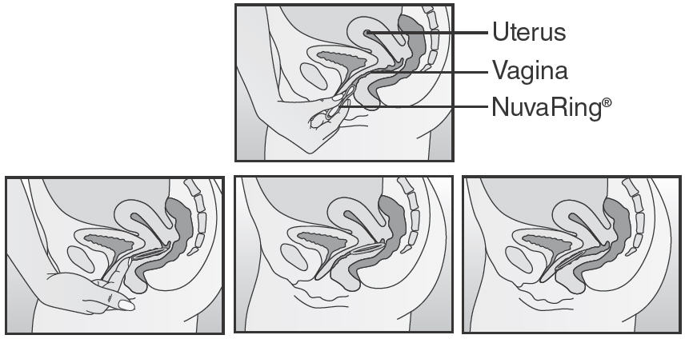
Nuva Ring

Slide 17
IUD
Intra Uterine Device (IUD)- is a instrument inserted through the cervix and placed at the bottom of the uterus and prevents fertilization of the egg.
IUD can be left in place for up to five years.
Features a quicker return to fertility rate much faster than most chemical contraceptives.
99% effective at preventing pregnancy. Must be inserted and removed by a doctor.

Slide 18
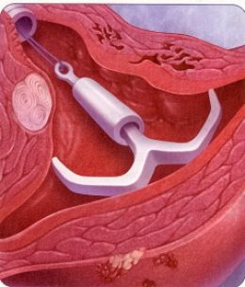
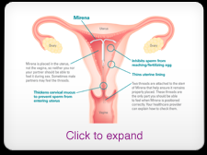
Mirena

Slide 19
Patch
Orthro Evra is a patch applied to the skin and works similar to the birth control pill.
Patch is left in place for one week.
Delivers a high dose of estrogen, so there is a higher than normal risk of blood clots or stroke using the patch. 60% more estrogen than the pill.

Slide 20
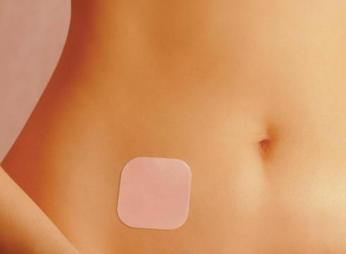
Orthro Evra

Slide 21
Implanon
Implants are inserted under the skin and release chemicals to “fool the body into thinking it is pregnant already” they are as close to 100% effective as any contraceptive.
They like ALL chemical birth control offer ZERO protection against STDs
Expensive without medical insurance ($approx. $800)

Slide 22
Implanon

Slide 23
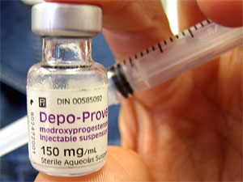
Depo
Depo is a shot that is taken every three months and if taken on the correct schedule is almost as effective as implanon.

Slide 24
Plan B
Plan B is the “morning after pill”, it is designed to prevent ovulation or to prevent the fertilized egg from implanting in the uterus, it is not effective if the person is already pregnant.
Plan B DOES NOT cause a miscarriage like some oral “after sex” contraceptives.

Slide 25
Contraception
Abstinence is the only form of birth control that is completely 100% effective all the time.
If you feel that the time is right to discuss contraception than it is important to discuss with your medical professional and get current and up to date statistics and information from someone who is best suited to make suggestions based on your own medical history and situations.

