Slide 1
Mr. Smith
Room 501
Exploring business & entrepreneurship
How is my grade calculated?
Communication
jacksmith@currituck.k12.nc.us
(252) 435-2566 ext. 9037
Communication
Course Description
Welcome to Exploring Business & Entrepreneurship! This course is designed to empower all students to be successful citizens, workers and leaders in a global economy. This course will give purpose to learning by emphasizing real world skills and practical knowledge. Students will think creatively, solve problems and utilize technology to do so. All while reinforcing their basic core skills of reading, writing and mathematics while working independently and as part of a team.
Classwork / Homework
40% of your grade will be based on classwork activities such as worksheets, short written responses, note-taking, and reflections over lecture and topics discussed.
Projects / Unit Tests
25% of your grade will be based on unit tests and project completion. There will be projects completed individually as well as within a group.
Quizzes
25% of your grade will be based on quizzes. These quizzes will be placed periodically throughout a unit to reinforce learning and comprehension.
Workplace Readiness Skills
10% of your grade will be based on observed workplace readiness skills. Having the ability to be assigned a task and completing the task in a timely manner. Having the ability to be productive and prepared while in the classroom. This will be observed with morning bell ringers, exit tickets, reflections, and Journal entries.
Module 1:
Understand the purpose of business, types & classes of business
Compare the main types of business organization
Classify business as profit-making or non-profit making, and service, product or combination of both.
Module 2:
Recall personal characteristics and skills needed for a successful entrepreneur.
Understand entrepreneurship and the entrepreneurial process
Understand the procedures for starting a business
Academic Integrity
All work in this class is expected to be your own, completed by you for this class. If you receive help from an article, book, website, another person, et., you must indicate that on the assignment. This is called citing your sources.
When you take credit for someone else’s work, it is called plagiarism. I will help you throughout this semester on this.

Slide 2
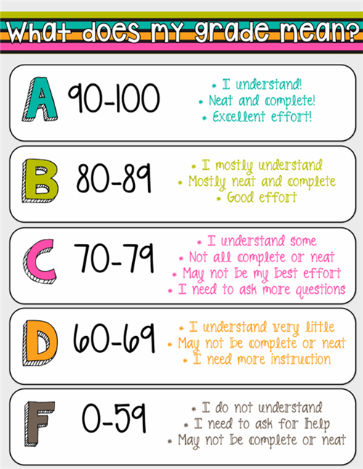
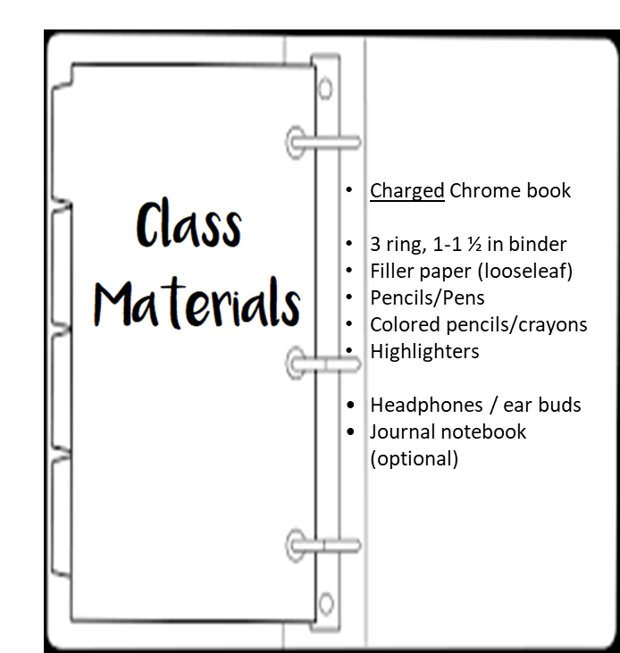
Classroom Procedures & Expectations
Entering Class:
If classroom door is closed, please wait in the hall until I open it.
Upon entering, look at the board and/or TV monitor and follow instructions as you see.
There will be something on the board every day.
Cell Phones:
Cell phones should be left in your locker.
If on person, keep cell phones out of sight unless permission is given for class work.
Ensure ringer and notifications are silent
Cell phone holder on back of the door if needed and will be used to store phones that are becoming an issue.
Continued violations, parents/guardians will be called and a referral to Admin.
Food and Drink:
You are allowed to have water in the classroom
Fill your water bottle between classes
No food or gum allowed in the classroom at any time.
Hall Pass:
There will be a sign out/in sheet on the teacher's desk when leaving and returning to the classroom.
No more than two people will be allowed out of the classroom at one time.
You must gain permission from the teacher to leave the classroom for any reason.
There will be no Hall Pass allowed for the first 5 minutes of class and the last 5 minutes of class.
Leaving Class:
You will be given two minutes to pack up at the conclusion of class.
Do not pack up early or gather by the door until told to do so.
Your areas will be cleaned and organized prior to dismissal.
Computers will be logged off, keyboards placed back where they belong, and monitor covers back in place.
Class Materials:
Bring all materials required each day for class participation.
This includes a charged Chromebook and charging cable.
Bring a good attitude!
Bring enthusiasm!
Bring curiosity!
Absences & Late work:
If you are absent from class, YOU are responsible for getting and making up any missing/late work.
Late work will be accepted up to (5) days after returning to school, however;
After (5) days from returning, each additional day an assignment is late, points will be deducted from that grade. After 10 days, students will not receive more than 50%.
Every Procedure has a purpose; to help us learn better!

